Slide 1

Text Analysis of News Headlines and Correlation Analysis with Tech Stock Prices

Slide 2

Agenda
Tractable data
Data retrieval
Exploratory Data Analysis
Implications for stakeholders
Ethical, legal, societal implications

Slide 3
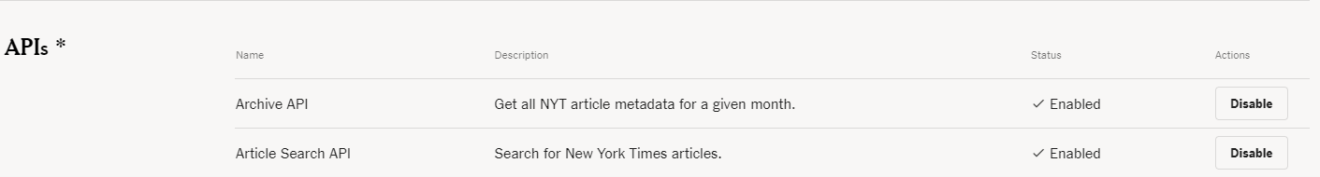
Tractable data
New York Times API
Create a developer account and enable the API to get the archival articles metadata.
Link: https://developer.nytimes.com/apis

Slide 4
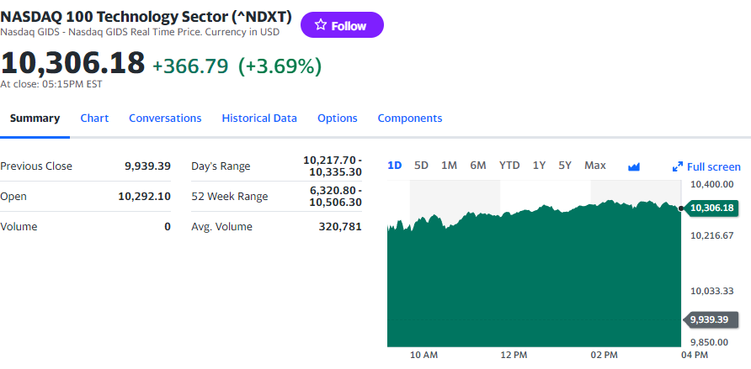
Tractable data
NASDAQ 100 Technology Sector (^NDXT) from Yahoo Finance
Link: https://finance.yahoo.com/quote/%5ENDXT/

Slide 5
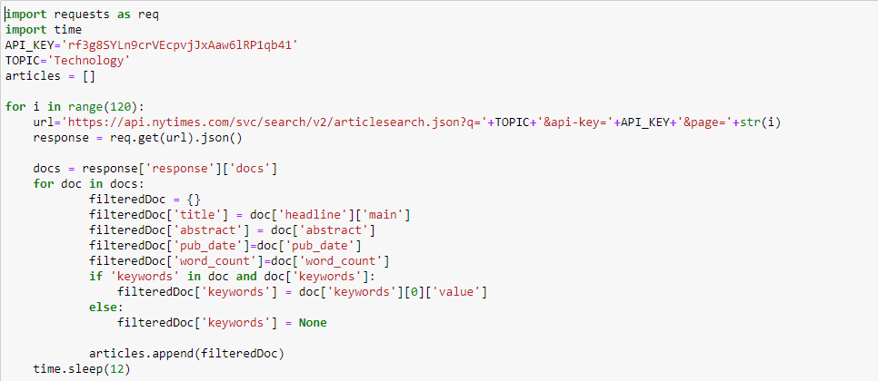
Data retrieval
New York Times data
Get archived technology articles from 120 pages
Filtered some features: titles, abstracts, published date, keywords, word counts

Slide 6
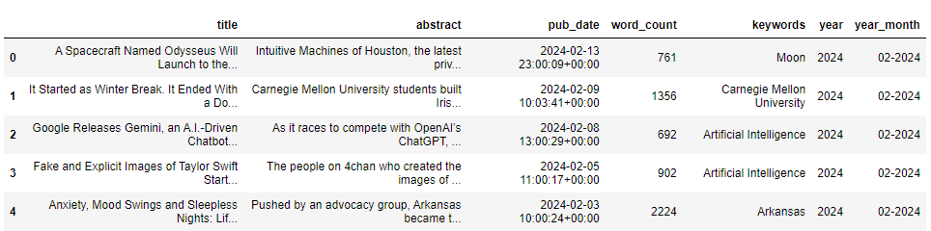
Data retrieval

Slide 7
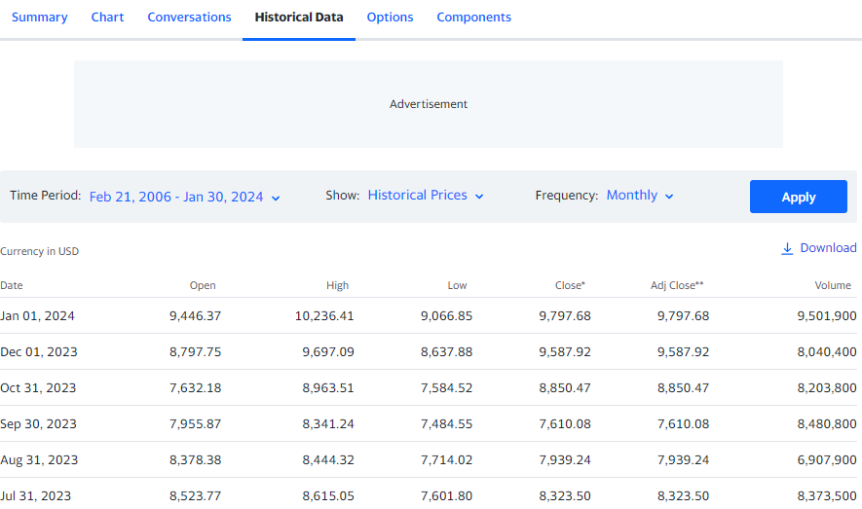
Data retrieval
NASDAQ 100 Technology Sector

Slide 8
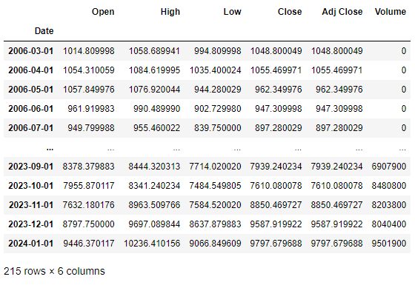
Data retrieval

Slide 9
Exploratory Data Analysis
Statistics of the data
Plots for visualization
Text analysis (NLP)
Correlation Analysis

Slide 10
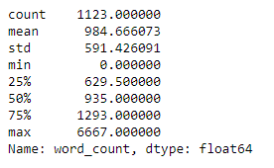
Statistics of the data
After the wrangling process, the data frame contains 1123 rows and 7 columns.
126 articles don’t have a keyword.
Statistics of the articles’ word count:

Slide 11
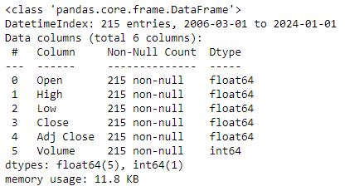
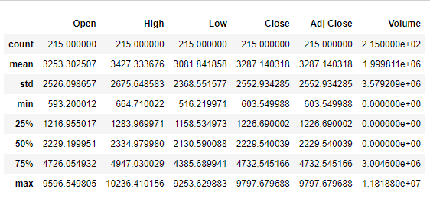
Statistics of the data

Slide 12
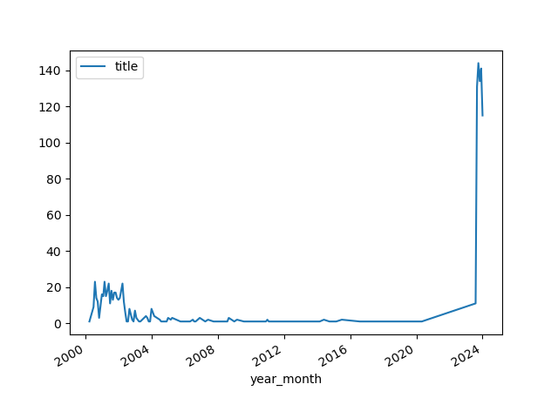
Data Visulization
Monthly count of articles

Slide 13
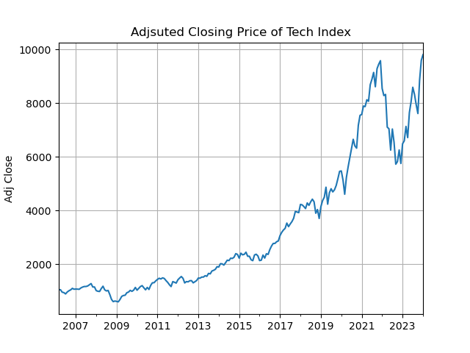
Data Visulization

Slide 14
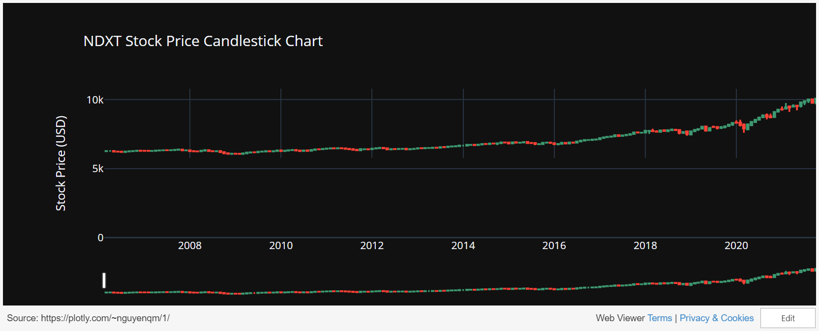
Data Visualization

Slide 15

Text Analysis
Concatenated the title and the abstract and made words lower case
Removed punctuation and special characters
Tokenized sentences and removed stop words
Made a list of 100 tech-related keywords (AI generated)
Calculate similarity scores with tech vocabulary for each token using cosine similarity
If the score > 0.7, the token is counted as a tech-related keyword

Slide 16
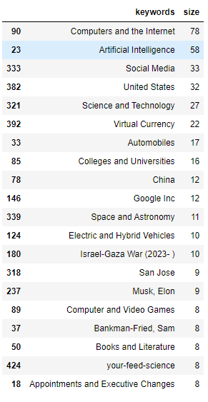
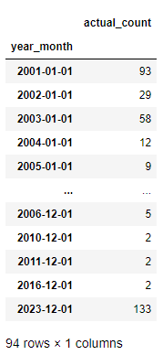
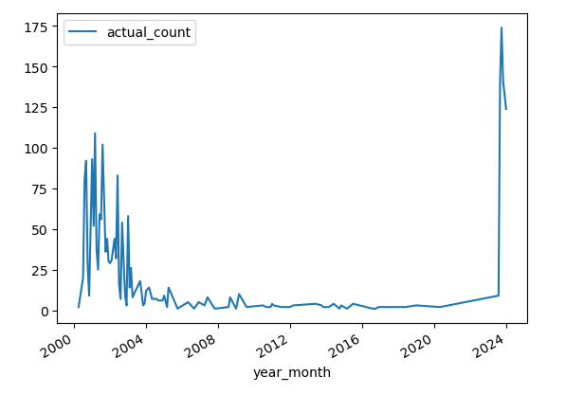
Text Analysis

Slide 17
Correlation Analysis
Pearson coefficient: quantifies the strength and direction of a linear relationship between two variables. In this case, they are the number of keywords and the adjusted closing price.
Using the .corr() method, the result is: 0.822
This suggests a strong linear relationship between the 2 variables.
But …
Let’s look at the scatter plot of these 2 variables

Slide 18
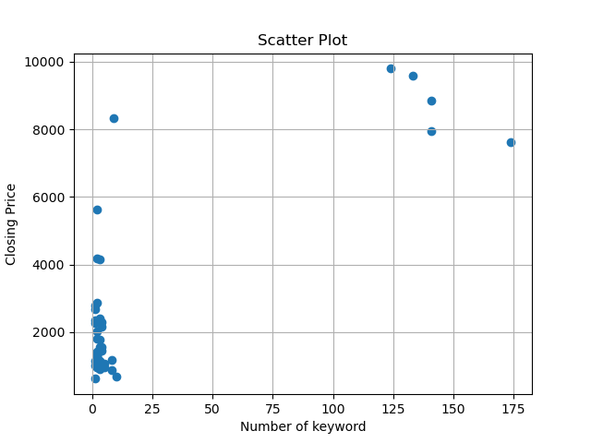
Correlation Analysis
It doesn’t look right, does it?
This is because Pearson’s method assume that the distribution of both variables are normal.
However, they are not. (According to the Shapiro-Wilk test)

Slide 19
Correlation Analysis
So, the alternative method is the Spearman method.
This method is suitable because:
It is a non-parametric measure of statistical dependence between two variables.
It doesn’t assume normality of the data.
The result is: 0.211
This indicates a weak positive correlation. This means there's a slight tendency for stocks with more keywords in their news titles to have higher prices, but the relationship is not very strong.

Slide 20
Implications for stakeholders
Investors:
Relying solely on media content for investment decisions may not be advisable. Other fundamental and technical factors should also be considered.
Financial Media:
Media outlets may consider creating educational content to help investors understand how various factors, including media coverage, can influence stock prices. This can empower investors to make more informed decisions based on a deeper understanding of market dynamics.
Tech companies:
Tech companies might want to be aware of the potential impact of media coverage on their stock prices. However, they should also recognize that other factors, such as financial performance and market trends, play a significant role.

Slide 21
Ethical, legal, societal implications
Ethical
Prioritize accurate and truthful reporting to fulfill the ethical responsibility of providing reliable information, avoiding potential impacts on stock prices and maintaining transparency and ethical journalism standards.
Legal
Exercise caution to prevent legal actions due to false statements or misinformation harming the reputation of companies or individuals.
Societal
Even weak media influence on stock prices can impact market stability, affecting investors and the broader economy.
Ethical and accurate reporting enhances investor confidence, while mismanagement of information may erode trust in the financial media.
Promoting information appropriately and transparently helps to level the playing field for all investors and improves financial literacy.

